Slide 1

GROUP – B
ANKIT KUMAR SHAW
SUPARNO CHAKRABORTY
SUNANDA SARKAR
AKASH
SHAH

Slide 2


URBAN
CHAP TERS

Slide 3



Description
The study, which examined 70,059 original meta description examples, also discovered that:
In 15.4% of cases, Google used the original meta description tag but added some text.
In 51.3% of cases, the display snippet perfectly matched the meta description tag or fully contained it.
In 3.2% of cases, the display snippet used a truncated version of the meta description tag with an ellipsis on the end.
Stick to your brand voice and tone, but also keep it conversational.
Include your primary keyword if you can do so naturally, to tick the minimum of requirements for an SEO meta description.
Make sure you convey value to the reader.
Include a call-to-action, i.e. “Learn more here.”
Write in active voice.

Slide 4
INDEX pAGE
Home page: It is the landing page where the user first visits the website.
Here in this page, the website shows array of books for purchase by the user.
A section of free public domain and other books will be available for the registered user to download and read.
A built-in e-book reader will be provided by the website and made available to the user to read the purchased books from their profile list.
There is a user authentication system present and the user will have to register and create a free account for purchases and for using the e-book reader.
In this home page, header contains project logo and a GIF.
After, navigation bar contains home, featured, arrivals, reviews including login/register button and a search bar.
After, side menu bar contains some book categories like- thriller, comedy, romance, fiction, horror kids etc.
Featured page contains some array of books.
The website also provides a “Request Book” page where the user can submit a request to the admins for an unavailable book.

Slide 5

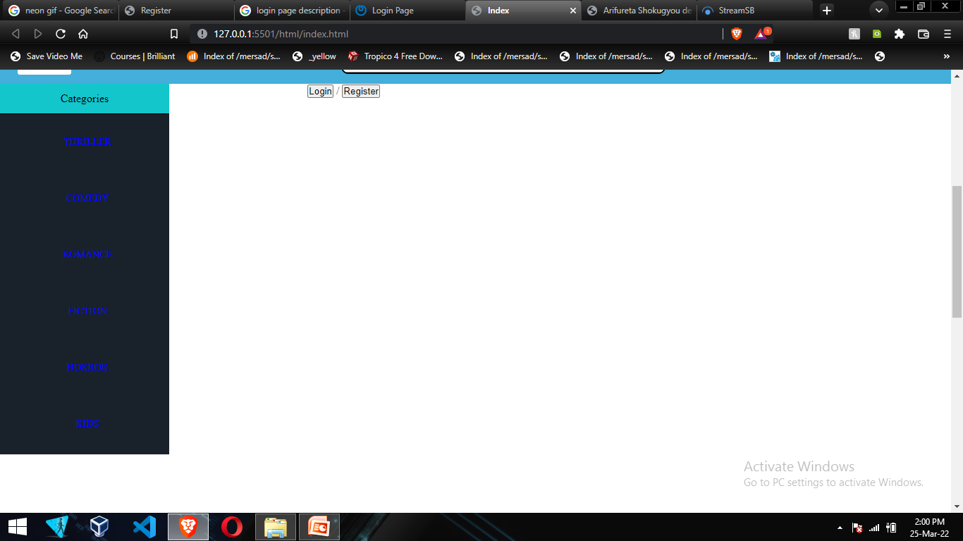
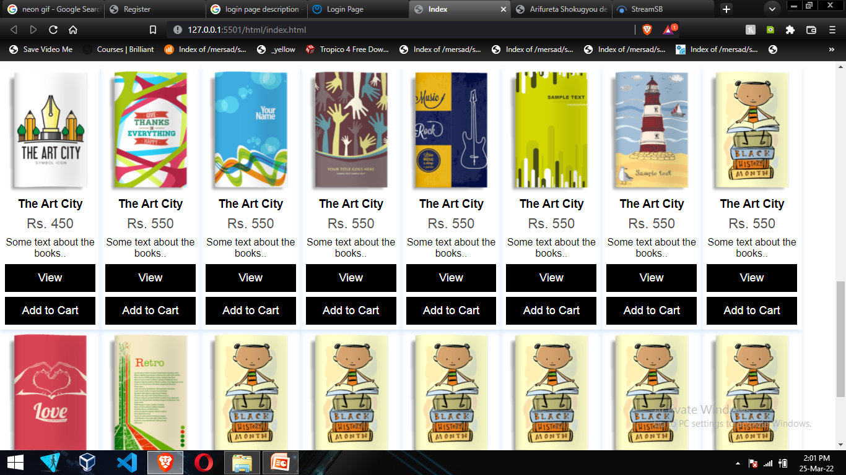
INDEX pAGE

Slide 6
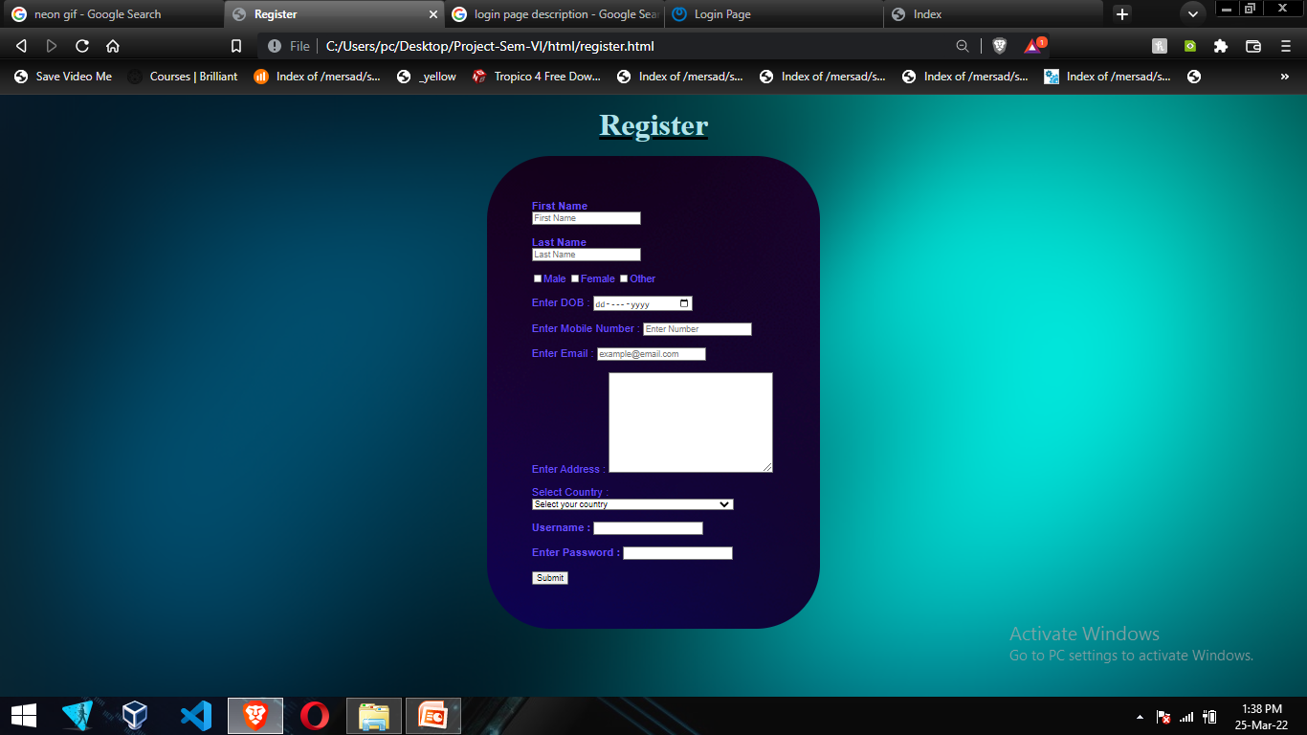
REGISTER pAGE
Register page allows to create an account for the user.
Field Requirements
first name
last name
gender check
date of birth
mobile number
Email
address
password

Slide 7
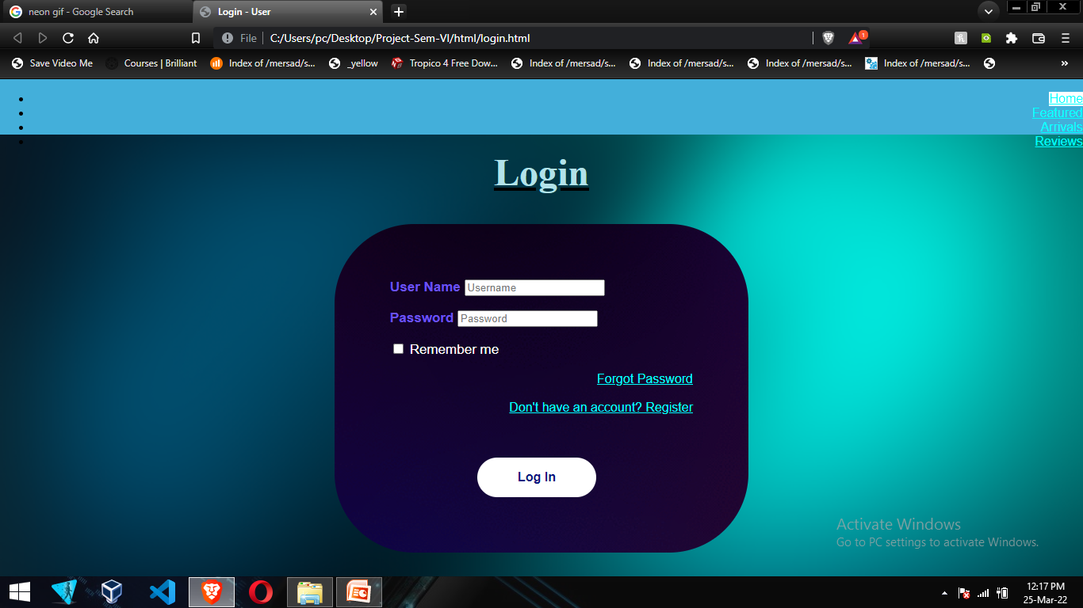
LOGIN pAGE
The login page

Slide 8
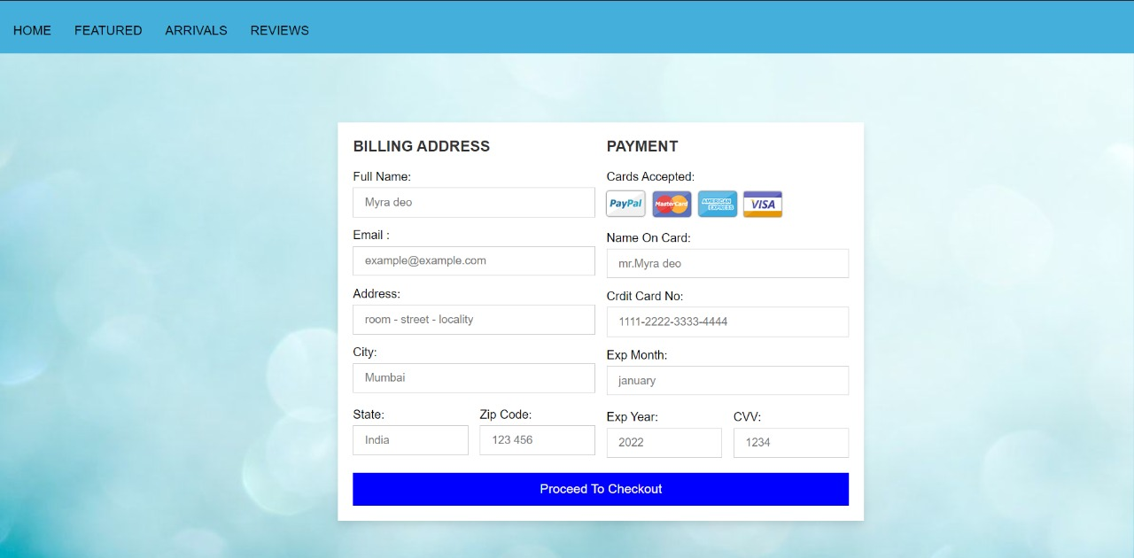
PAYMENT pAGE

Slide 9
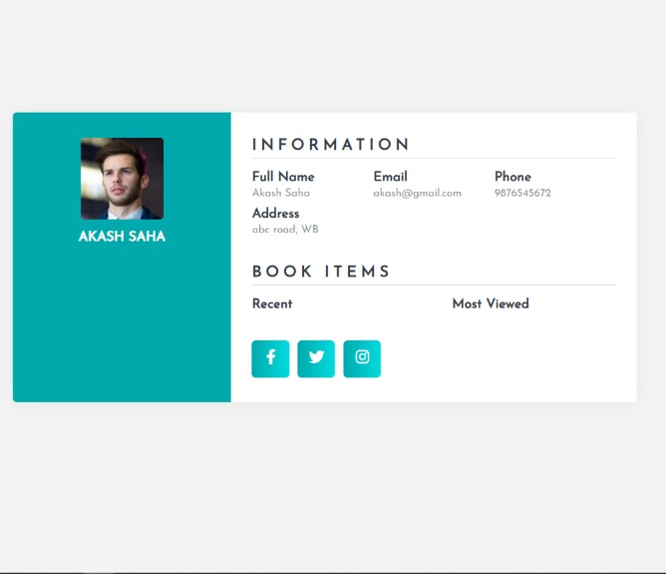
USER Profile pAGE

Slide 10
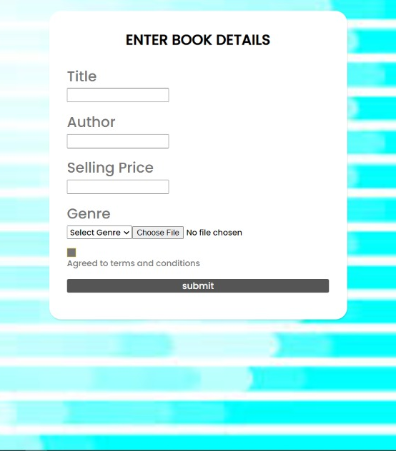
PUBLISHER pAGE

Slide 11
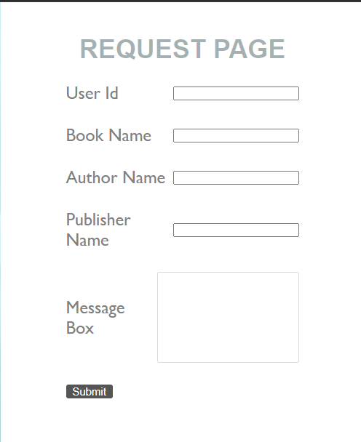
REQUEST pAGE

